Slide 1
React JS
(the usereducer() hook)
Lecture-35

Slide 2
Today’s Agenda
Introduction To Reducer In JS
The reduce() Method
Understanding useReducer() Hook
Example

Slide 3
What Is useReducer() ?
useReducer() is one of the additional Hooks that shipped with React 16.8.
Just like useState() , it also helps us manage state but is very useful when we have complex state logic in React applications.
However to understand useReducer() in a better way we must first understand the term reducer .

Slide 4
What Is Reducer ?
A “reducer” is a fancy word for a function that takes 2 values and returns 1 value.
Points To Remember:
The first and most important thing to understand about a reducer is that it will always only return one value.
The job of a reducer is to reduce.
That one value can be a number, a string, an array or an object, but it will always only be one.

Slide 5
The reduce() Method Of Array
Based on the concept of reducer , we have the reduce() method which belongs to Array object .
It has the following syntax:
result=arr.reduce( call_back_fn , initialvalue)
It accepts 2 arguments
The first argument is a callback function and the second argument is a starting value
It then calls that callback function passing it the initial value and the array’s first element.
Collects the result returned by the callback function and then again calls that callback function by passing it the next array element and the previous return value
Finally it returns the last value returned by call back as result

Slide 6
The reduce() Method In JS
Suppose we have an array of numbers, and we want to add all the values .
Then the modern way to do that is to use Array’s reduce() function.

Slide 7
The reduce() Method In JS
Solution 1:
function add(total, n) {
return total + n;
}
const arr = [10, 20, 30, 40, 50];
let sum = arr.reduce(add, 0);
document.write("Array is:" + arr);
document.write("<br>");
document.write("Sum of array elements is:" + sum);

Slide 8
The reduce() Method In JS
Solution 2:
const arr = [10, 20, 30, 40, 50];
let sum = arr.reduce((total, n) => {
return total + n;
}, 0);
document.write("Array is:" + arr);
document.write("<br>");
document.write("Sum of array elements is:" + sum);

Slide 9
What Is useReducer() In React ?
The useReducer() hook takes two arguments which are a callback and initial state
Syntax:
const [state, dispatch] = useReducer(reducer, initialArgs);
Explanation :
Here reducer is the user-defined function to handle the state and initialArgs refers to the initial state

Slide 10
Return Value Of useReducer()
The useReducer() returns an array of 2 items: the current state and the dispatch function.
The dispatch Function:
The dispatch function is created for us by the useReducer() hook.
Whenever we want to update the state we simply call the dispatch function with the appropritate action object: dispatch(actionObject).
The action Object:
An action object is an object that describes how to update the state.
Generally, the action object would be a string describing what kind of state update the reducer must do.

Slide 11
Exercise 1
Create a Functional Component which displays a button titled Click Me and a counter initially set to 0
When the button is clicked the counter should increment by 1

Slide 12
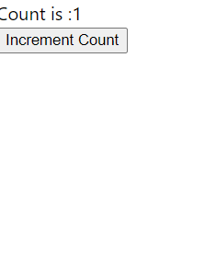
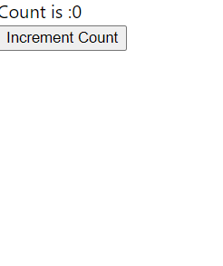
Desired Output
Before Click
After Click

Slide 13
Solution
MyCounter.js
import { useReducer } from "react";
const doSomething = (state, action) => {
switch (action) {
case "increment":
return state + 1;
}
};
function MyCounter() {
const [state, dispatch] = useReducer(doSomething, 0);
const handleClick = () => {
dispatch("increment");
};
return (
<div>
Count is :{state}
<br />
<button onClick={handleClick}>Increment</button>
</div>
);
}
export default MyCounter;

Slide 14
Exercise 2
Modify the previous code so that now we have 3 buttons titled Increment, Decrement and Reset respectively
When any of the button is clicked the counter should change accordingly

Slide 15
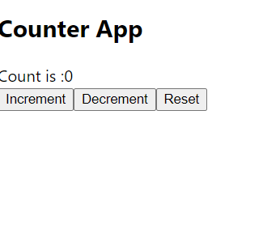
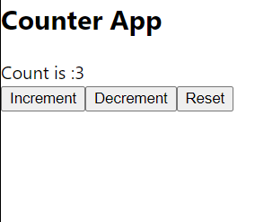
Desired Output
Before Click
After Click

Slide 16
Solution
MyCounter.js
import { useReducer } from "react";
const doSomething = (state, action) => {
switch (action) {
case "increment":
return state + 1;
case "decrement":
return state - 1;
case "reset":
return 0;
}
};
function MyCounter2() {
const [state, dispatch] = useReducer(doSomething, 0);

Slide 17
Solution
MyCounter.js
return (
<div>
Count is :{state}
<br />
<button
onClick={() => {
dispatch("increment");
}}
>
Increment
</button>
<button
onClick={() => {
dispatch("decrement");
}}
>
Decrement
</button>
<button
onClick={() => {
dispatch("reset");
}}
>
Reset
</button>
</div>
);
}
export default MyCounter2;

